Slide 1
Almost everything you need to know about Partial Least Squares: The Reboot
Part 1
Derek Beaton & Jenny Rieck

Slide 2
What is Partial Least Squares?
“If what you are looking for is an official definition of PLS I’m afraid you won’t find such thing.” - Gaston Sanchez
But maybe we’ll give it a try
Given two data sets—X and Y—we want to
Identify a common structure (covariance)
Sometimes predict things

Slide 3
A note about nomenclature
“If what you are looking for is consistent terminology I’m afraid you won’t find such thing.” - Derek Beaton!
A lot of disciplines and traditions have contributed to PLS development and application
Lots of variability on terminology
Today’s terminology: Primarily based on Principal Components Analysis (Part 1) and the PLSGui in Matlab (Part 2)

Slide 4
Part 1 and Part 2
Part 1: Generally an overview
Background for PLSC and PLSR
Resources and examples to do PLSs in R
Part 2: How to with neuroimaging
Going over data
Examples and interpretations of PLSC in Matlab

Slide 5
The Reboot vs. The Original
Reboot is more focused and shorter
Reboot has less math, original is far too serious
Reboot introduces partial least squares regression
Reboot slides are very boring looking (“optimized for Zoom”, yuck)
Original was actually in person ain’t that a weird concept
A lot of overlap, but both are worth the time

Slide 6
Part 1

Slide 7
Outline
The data we’re working with
PLS Correlation (PLSC)
PLS Regression (PLSR)
Resampling
How to do PLSC, PLSR, and resampling in R
Variations, relations, and limitations
Notes:
I will be going for ~ 45 minutes. So we can do some questions during, some after. Then some again in the final Q & A. I need to dip out briefly.

Slide 8
Outline
The data we’re working with
PLS Correlation (PLSC)
PLS Regression (PLSR)
Resampling
How to do PLSC, PLSR, and resampling in R
Variations, relations, and limitations

Slide 9
The Data

Slide 10

Our example data
A (modified) version of ONDRI Toy Data: https://github.com/ondri-nibs/toy_data
One data file, lots of variables to have fun with
Notes:
Split this

Slide 11
Data for today
Split the data into two data sets
X: Age and brains
Age
Total (percentage of) normal appearing grey matter (NAGM)
Total (percentage of) normal appearing white matter (NAWM)
Y: Cognition (processing speed)
Seconds to perform Trails A (Attention/working memory)
Seconds to perform Trails B (Executive function)
Seconds to perform Stroop colors (Attention/working memory)
Seconds to perform Stroop words (Attention/working memory)
Seconds to perform Stroop inhibition (Executive function)
Seconds to perform Stroop switching (Executive function)

Slide 12
Partial least squares correlation (PLSC)

Slide 13
PLS Correlation (PLSC)
a.k.a.
Coinertia analysis (Dray, 2014)
PLS correlation (Krishnan et al., 2011)
PLS-SVD (Tenenhaus, 1998)
PLS (McIntosh et al., 1996)
PLS (Bookstein, 1992)
SVD of the covariance between two fields (Bretherton, Smith, & Wallace, 1992)
(Tucker’s) Interbattery analysis (Tucker, 1958)
And many more
BPLS or PLS “mode B”
A relaxed version of canonical correlation analysis (we’ll see this much later)

Slide 14
What does PLSC do?
Describe common structure between X & Y
Very apt description: SVD of the covariance between two fields matrices (Bretherton, Smith, & Wallace, 1992)

Slide 15
A guide
I’m going to show (lots) of matrices visually, as heatmaps
They (mostly) accurately reflect the matrix algebra
When you see ^{T}, that means transpose (rows ← → columns)
Two matrices next to each other are matrix multiplication
I do get a bit lazy/loose with vectors vs. matrices later (but this is still mostly accurate)
I will point towards places to dive in more formally in the references

Slide 16
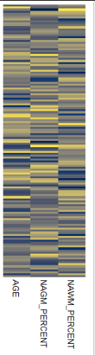
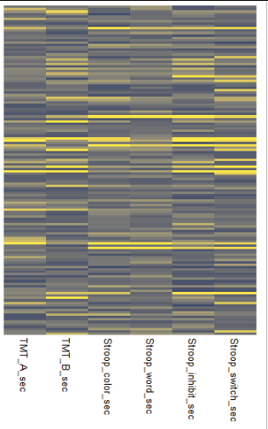
X
Y

Slide 17
X^{T}
Y
Notes:
More animation

Slide 18
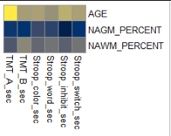
R =
X^{T}
Y
The Relationship between X and Y
covariance (if on the same scale) or
correlation (if on different scales; more common)
Notes:
More animation

Slide 19
R =
The Relationship between X and Y
The fundamental thing we’re working with

Slide 20
The Singular Value Decomposition
Probably tied for first as “the most important tool” in statistics, machine learning, and everything beyond and in between
Linear regression is the other one
And we’re going to see why the SVD almost certainly takes the lead
What does it do?
Take a rectangular matrix
Break it into 3 new matrices
Make everything orthogonal
Tell us how much variance we have for all those orthogonal slices

Slide 21

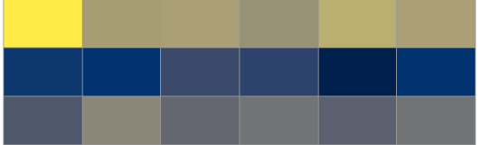

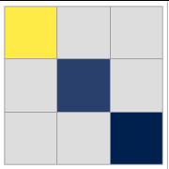
R =
U
D
V^{T}
AGE
NAGM
NAWM
TMT A
TMT B
Stroop color
Stroop word
Stroop inhibit
Stroop switch
Singular vectors of the ROWS of R
Singular values (variance)
THIS IS PRINCIPAL COMPONENTS ANALYSIS OF R See my previous workshops on PLS & PCA for PCA refreshers
OR AS WE APTLY SAID BEFORE: “SVD OF THE COVARIANCE BETWEEN TWO MATRICES”
Singular vectors of the COLUMNS of R
Notes:
What are U D and V? Reanimate or additional animation
HERE:: EIGENVALUES.

Slide 22

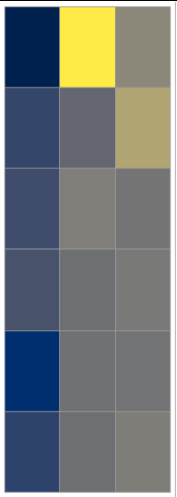
AGE
NAGM
NAWM
AGE
NAGM
NAWM
F_{J}=
U
D
F_{K}=
V
D
TMT A
TMT B
Stroop color
Stroop word
Stroop inhibit
Stroop switch
TMT A
TMT B
Stroop color
Stroop word
Stroop inhibit
Stroop switch
Notes:
(1) these are the loadings; columns are orthogonal and ordered by values in D, (2) these are the component scores; these are (usually) what we visualize and interpret

Slide 23
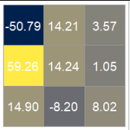
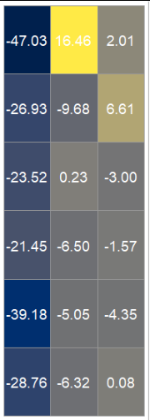
AGE
NAGM
NAWM
Component 1
Component 2
TMT A
TMT B
Stroop color
Stroop word
Stroop inhibit
Stroop switch

Slide 24
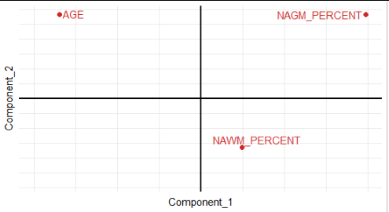
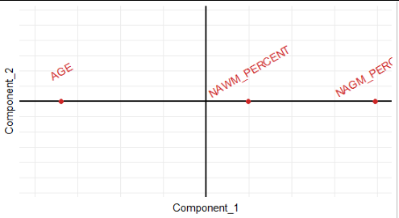
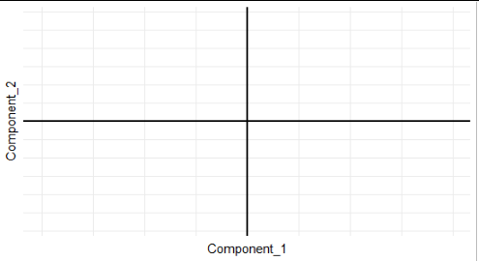
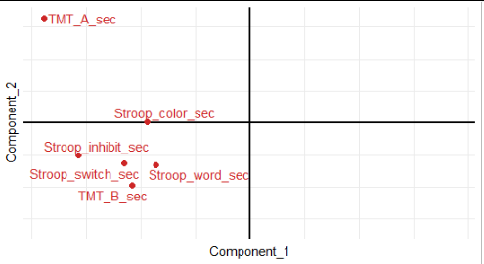

F_{J}: Variables from X
F_{K}: Variables from Y

Slide 25
What about participants?

Slide 26
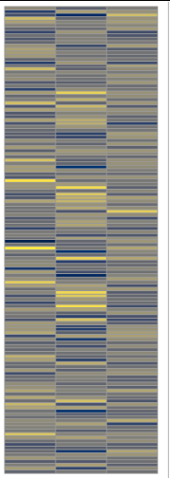
L_{X}=
X
U
AGE
NAGM
NAWM

Slide 27
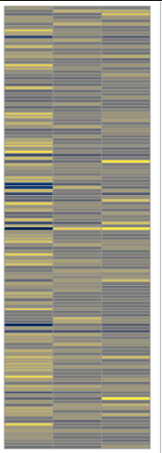
L_{Y}=
Y
V
TMT A
TMT B
Stroop color
Stroop word
Stroop inhibit
Stroop switch

Slide 28
L_{X}
VS
L_{Y}
Latent Variable 2
Latent Variable 1

Slide 29
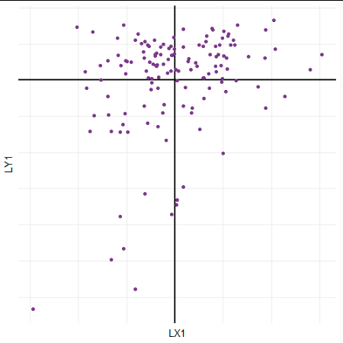
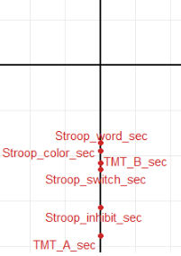
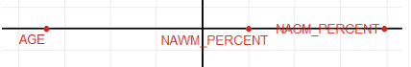
Faster
Younger
More GM
F_{K}: Component 1
Higher times
Lower times
Observations
Slower Older Lower GM
Older, lower GM
Younger, higher GM
F_{J}: Component 1
Notes:
Just discuss this one, and do so in the context of FJ and FK

Slide 30
The story we’d write
Component 1. The component scores for X showed that age and grey matter were (strongly) negatively correlated, and they were the primary effects observed on Component 1 (for X’s component scores). The component scores for Y showed that all cognition variables loaded in the same direction, and so are positively correlated with one another. Taken together, the component scores from X and Y show that higher processing speed was associated with higher age and lower grey matter in our sample.

Slide 31
What does PLSC optimize?
Maximize relationship between L_{X} and L_{Y}
Subject to (some) orthogonality between L_{X} and L_{Y}

Slide 32
L_{X}
L_{Y}
D
79 | 0 | 0
0 | 21 | 0
0 | 0 | 9
0
79
0
21
9
Notes:
What does PLS do? This will be one of the links to PLSR

Slide 33
BIG PAUSE
Data: Separate measures, same participants
X: One set of measures
Y: Another set of measures
R: The relationship between X & Y
R = UDV^{T}: The SVD
D²: The eigenvalues (explained variance)
Component scores: How to interpret what’s going on
F_{J} : Measures of X
F_{K}: Measures of Y
Latent variables
L_{X}: Participants of X
L_{Y}: Participants of Y

Slide 34
BIG PAUSE
PLSC is the simplest of PLSs
Almost everything is orthogonal
One pass with the SVD
PLSC is the core of (nearly) all other PLSs
Plus tons of variations and related techniques
Everything before this gives you ~75% of all PLS knowledge
But 75% of PLS users do not know PLSC as (a) PLSs

Slide 35
little breather
Notes:
Questions or concerns before moving on?

Slide 36
PLS to the ears of others
If you say “partial least squares” or “PLS” to:
Chemometricians
Statisticians
Some psychometricians who enjoy path modelling and PLS
Most people in machine learning
Virtually anyone in data science and applied domains
The French or Swedish
It’s a different PLS than what we just learned (PLSC)

Slide 37
Partial least squares regression (PLSR)

Slide 38
PLS regression (PLSR)
Contrary to PLSC, PLSR does:
not have many different names
have many different ways (algorithms) to compute results
We’re going to look at just one algorithm, which is just one version of “simple PLS” (SIMPLS)

Slide 39
What does PLSR do?
Two big things:
Describe common structure between X & Y (See PLSC)
Predict all Y from all X
Give an OLS-like solution when you don’t have an OLS problem
Multicollinearity
Lots of Y
Fewer observations than variables (especially in Y)
Notes:
This is especially in contrast to PLSC. Maybe do side by side? Maybe do just one list of what PLSR is?

Slide 40
What does PLSR do?
Two big things:
Describe common structure between X & Y (See PLSC)
Predict all Y from all X
Give an OLS-like solution when you don’t have an OLS problem
Multicollinearity
Lots of Y
Fewer observations than variables (especially in Y)
Notes:
This is especially in contrast to PLSC. Maybe do side by side? Maybe do just one list of what PLSR is?

Slide 41
Input: X, Y
for c = 1, ..., C; do
PLSC(X, Y)
Using only the first component/latent variable
T ← L_{X} / sqrt(sum(L_{X})²)
B ← L_{Y}^{T}T
P ← T^{T}X
Reconstruct X & Y
X` ← TP
Y` ← TBV
Deflate X & Y
X ← X - X`
Y ← Y - Y`
Go to Step 1 with new(ly deflated) X & Y

Slide 42
Input: X, Y
for c = 1, ..., C; do
PLSC(X, Y)
Using only the first component/latent variable
T ← L_{X} / sqrt(sum(L_{X})²)
B ← L_{Y}^{T}T
P ← T^{T}X
Reconstruct X & Y
X` ← TP
Y` ← TBV
Deflate X & Y
X ← X - X`
Y ← Y - Y`
Go to Step 1 with new(ly deflated) X & Y

Slide 43
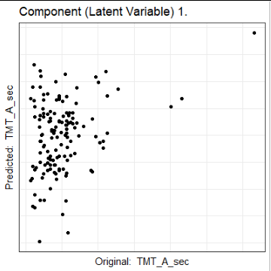
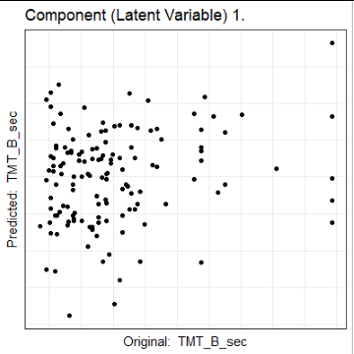
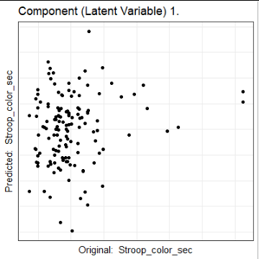
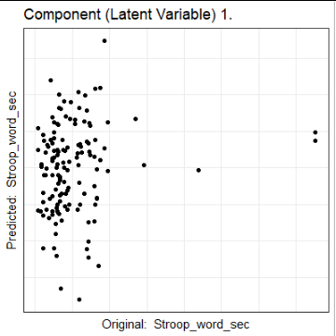
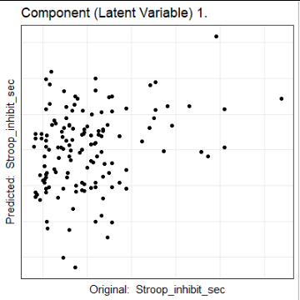
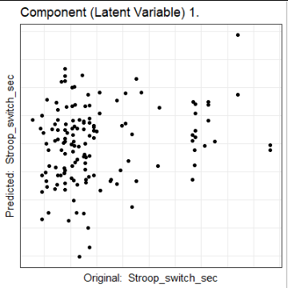

Slide 44
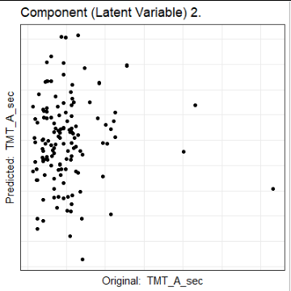
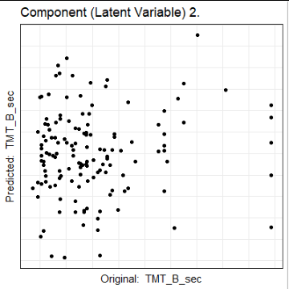
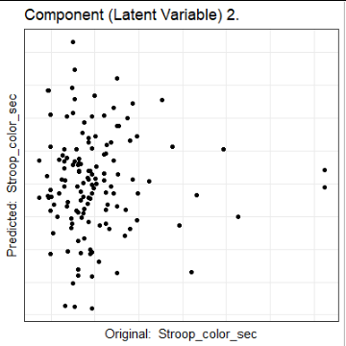
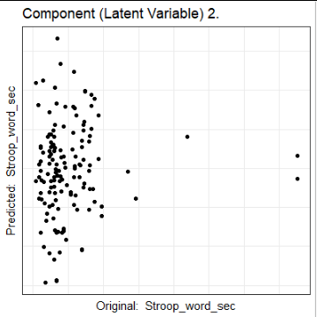
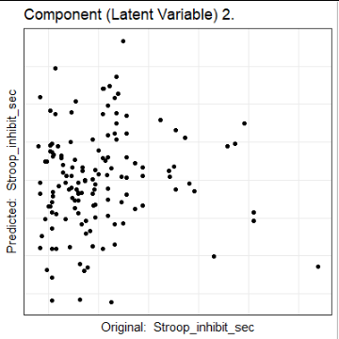
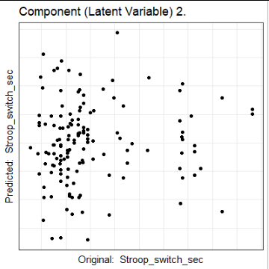

Slide 45
What happens with C1 + C2?
We don’t have to look at them separately
We can look at them together
Not just Component 1 then Component 2, but Component 1 + Component 2

Slide 46
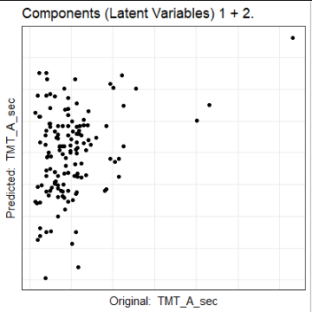
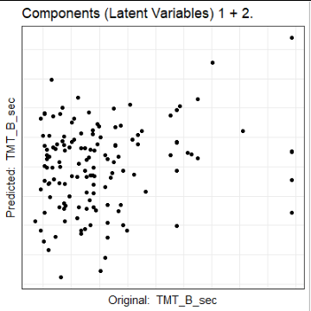
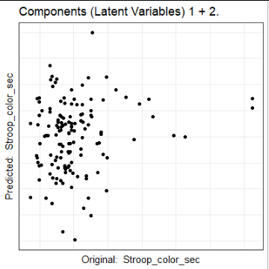
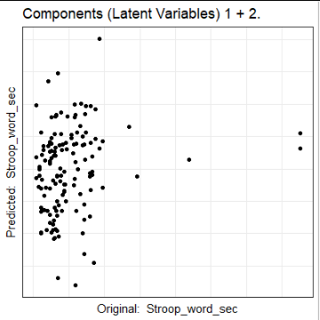
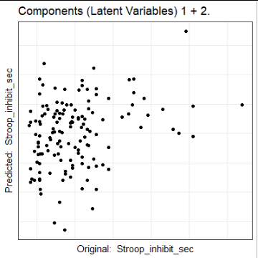
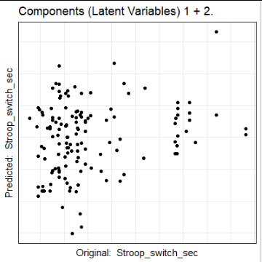

Slide 47
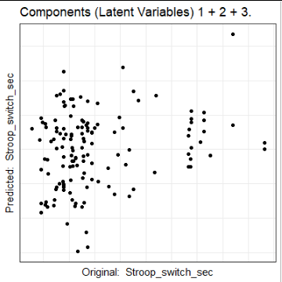

Slide 48
Input: X, Y
for c = 1, ..., C; do
PLSC(X, Y)
Using only the first component/latent variable
T ← L_{X} / sqrt(sum(L_{X})²)
B ← L_{Y}^{T}T
P ← T^{T}X
Reconstruct X & Y
X` ← TP
Y` ← TBV
Deflate X & Y
X ← X - X`
Y ← Y - Y`
Go to Step 1 with new(ly deflated) X & Y

Slide 49
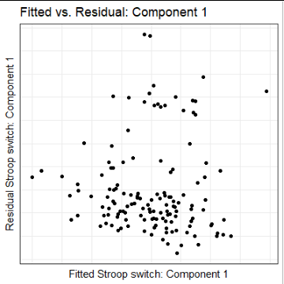
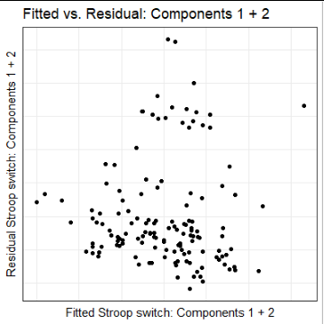
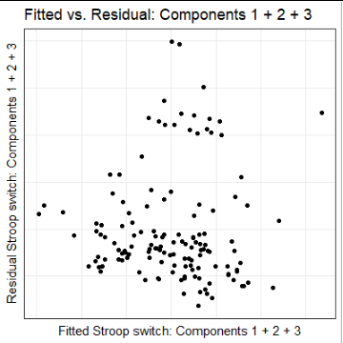

Slide 50
Another BIG pause
> lm_res <- lm(as.matrix(Y) ~ as.matrix(X))
> lm_res$fitted.values
...
> lm_res$residuals
...
Notes:
This sort of breaks the rules right? We have 3 X variables. Two of them (NAGM, NAWM) are very likely collinear, age probably too. And we have 6 Y variables.

Slide 51
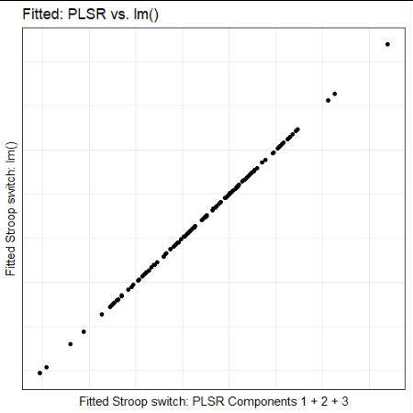
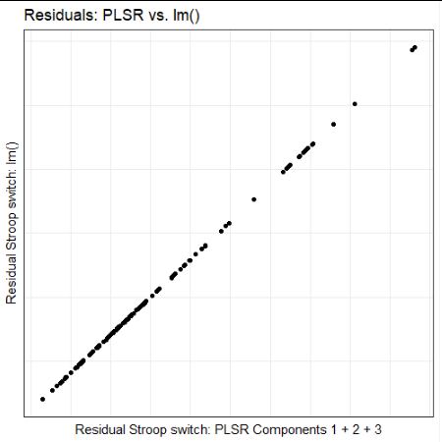
Notes:
WE HAVE UNLOCKED THE SECRETS OF PLSR. IT WAS A REGRESSION THE WHOLE TIME.

Slide 52
The secret of PLSR
PLSR and OLS (algebraically) give you the same fitted and residuals, when:
Using all components, and
The OLS itself does not explode
Theory and assumptions are more prone to explosion than the algebra
The algebra can definitely explode, too, though (e.g., matrix inverse)

Slide 53
The benefits of PLSR (over OLS and the like)
When you want to predict:
It’s technically a regularized OLS: “Soft modelling” - H. Wold
A soft regularization because we only use the good parts of the covariance matrix
The good parts are the high variance (first) components
Plus you get all those PLSC bells-and-whistles
Component scores
Latent variables
Explained variance is different but you still get explained variance
For X and for Y separately
Extra big bonus: the first component from PLSC and PLSR are identical

Slide 54
little breather
Notes:
Questions or concerns before moving on?

Slide 55
How to select components
We don’t need them all, we certainly don’t want them all
So how do we decide which to keep?

Slide 56
More generally: What do we interpret?
How many and/or which components?
Which variables are stable (“significant”)?
Do I have groups and are those groups different?
How good or bad is my model for prediction?

Slide 57
Resampling

Slide 58
Resampling is probably the best
Permutation: create null distributions, see if effect is outside of the null
Often used to select the number of components
Bootstrap: create effect distributions (confidence interval), see if effects are sufficiently far away from zero
Often used to identify variables to interpret, or variables that are stable (“significant”)
Leave one out, K-fold: prediction estimates (typically) for observations
Often used to assess predictive performance, or model selection, or feature selection
Includes:
Repeated K-fold
Leave-one-out bootstrap
Split-half resampling

Slide 59
Dive in to resampling
Previous workshops
Resampling workshop from April 2017
PLS (the original) from October 2017
PCA/MCA & Resampling from May 2019
The repository for this workshop
Lots of examples in R
tidymodels.org
statlearning.com

Slide 60
How to do PLS in R?

Slide 61
How to do PLS* in R?
I’ve provided LOTS of examples here:
https://github.com/derekbeaton/Workshops/tree/master/RTC/PLS
baby_plss.R: minimal forms of PLS in base R
Several practical examples (EXAMPLES_*.R)
PLSC with TExPosition & TInPosition: EXAMPLE_PLSC_TExPosition.R
PLSR with pls and vs. lm(): EXAMPLE_PLSR_pls.R
PLSR with pls & tidymodels: EXAMPLE_PLSR_tidymodels.R
Various PLSs with GPLS: EXAMPLE_PLSC_PLSR_gpls.R
Definitely see the old workshop we did from 2017 OCT
There are even videos around somewhere!
Notes:
We aren’t covering this, so see the workshop from Oct 2017.

Slide 62
Variations, relations, and limitations

Slide 63
Variations
PLS-path modelling
Multiple types of PLS-based discriminant analyses
PLS-DA
Barycentric discriminant analysis
Mean-centered PLS
PLS-Canonical
Symmetric like PLSCorrelation
Iterate and deflate like PLSRegression
PC-regression = PLSR = OLS when we use all components
Notes:
Make giant network graph? {CCA, RRR, PLS} <-> {PLSR, PLS-PM} Some whacky arrows to DAs Some whacky arrows to generalized regularized CCA with an arrow to the PMD CCA

Slide 64
Relations
Canonical correlation analysis (CCA) and reduced rank regression (RRR) are weighted versions of PLSC
Penalized/sparse CCA makes use of what we’d call PLSC
Fisher’s Linear discriminant analysis (LDA) is CCA
Thus another discriminant version of PLSC
Generalizations to more tables and different optimizations
See regularized generalized canonical correlation analysis (RGCCA, Tenehaus & Tenenhaus)
Notes:
Make giant network graph? {CCA, RRR, PLS} <-> {PLSR, PLS-PM} Some whacky arrows to DAs Some whacky arrows to generalized regularized CCA with an arrow to the PMD CCA

Slide 65
Limitations
"coding categorical variables with the indicator matrix of dummy variables and considering them as Gaussian, for instance, is almost a crime." (Husson, Josse, Saporta)
So don’t do that, I will report you to the (mostly French) data police
PLS-Correspondence Analysis (Beaton et al., 2016) and Generalized Partial Least Squares (Beaton et al., 2020)
For categorical, ordinal, or mixtures of those and continuous variables
Appendix is dedicated to connections between PLS, CCA, RRR and all their friends

Slide 66
References & Resources

Slide 67
Resources
Lots of good stuff here:
https://github.com/derekbeaton/Workshops/
https://github.com/jennyrieck/Workshops/
Our previous RTC workshops:
PLS: [either of our githubs]: /RTC/Oct2017
Resampling: [derek]/RTC/Apr2017
PCA/MCA & Resampling: [derek]/RTC/PCA_MCA_Resampling
Some other workshops:
Related techniques: [derek]/Misc/CA_MCA
Lots more related techniques: [derek]/ONDRI/Scholars_SEP2019_Ordination
tidymodels.org
statlearning.com

Slide 68
References
Abdi, H. (2010). Partial least squares regression and projection on latent structure regression (PLS Regression). Wiley Interdisciplinary Reviews: Computational Statistics 2(1), 97106.
Beaton, D., Saporta, G., & Abdi, H. (2019). A generalization of partial least squares regression and correspondence analysis for categorical and mixed data: An application with the ADNI data. bioRxiv, 598888.
Krishnan, A., Williams, L. J., McIntosh, A. R. & Abdi, H. (2011), Partial Least Squares (PLS) methods for neuroimaging: A tutorial and review. NeuroImage 56(2), 455-475.
McIntosh, A., Bookstein, F., Haxby, J. & Grady, C. (1996). Spatial Pattern Analysis of Functional Brain Images Using Partial Least Squares. NeuroImage 3(3), 143157.
Sanchez, G. (2015). The Saga of PLS. Retrieved from: https://sagaofpls.github.io/aboutpls.html
Tenenhaus, M. (1998). La régression PLS: théorie et pratique. Editions TECHNIP.
Tucker, L. R. (1958). An inter-battery method of factor analysis. Psychometrika 23(2), 111136.
Wold, H. (1975). Soft modelling by latent variables: the non-linear iterative partial least squares (NIPALS) approach. Perspectives in Probability and Statistics, In Honor of MS Bartlett pp. 117144.

